Slide 1
BE
T
I
F
FOR
FOOD SAFETY

Slide 2
Why Do We Practice Food Safety?
Food safety is important as it helps to protect students from the risk of foodborne illnesses.
Notes:
TELL : Food safety is important as it helps to protect students from the risk of foodborne illnesses.

Slide 3
Risks of Not Practicing Food Safety
When a foodborne illness breakout occurs there are serious consequences.
That’s it, we are packing you a lunch from now on, son!
Children May Become Ill
People May Lose Confidence In Your Operation
Notes:
TELL :When a foodborne illness breakout occurs there are serious consequences .Children may become ill or sick due to not practicing proper food safety .Parents , students and the public may loose confidence in LAUSD with the food we provide. This can result in financial lost to Food Services which may lower morale among staff .

Slide 4
Risks of Not Practicing Food Safety
Not only does it effect your customers, it also effects the cafeteria internally.
Lower Staff Morale
Financial Loss
Yeah, I’m out. Transfer me please.
Notes:
TELL :When a foodborne illness breakout occurs there are serious consequences .Children may become ill or sick due to not practicing proper food safety .Parents , students and the public may loose confidence in LAUSD with the food we provide. This can result in financial lost to Food Services which may lower morale among staff .

Slide 5
Is Your Kitchen Clean, Really?
Notes:
TELL: When managers complete the “Monthly Cafeteria Sanitation Checklist” candidly they are holding their cafeteria to the highest standard. When conducting your inspection utilize the “Active Managerial Control” by Identifying the risk honestly , addressing the corrective action and monitoring staff to verify they are completing the “Monthly Cafeteria Sanitation Checklist” correctly .The verification step may indicate that retraining is necessary .

Slide 6
How do you feel when the local health inspector comes to visit your cafeteria?
Notes:
TELL: This is the final step in Active Manager Control (AMC), You must verify the appropriate corrective actions have been taken for the risks that were identified and addressed.
Example: Once the Food Temperature logs have been completed by your staff, Verify that the information is correct .Sign the Food Temperature logs once you have Verified the information is is true, correct and in accordance with Food Services policies and procedures.

Slide 7
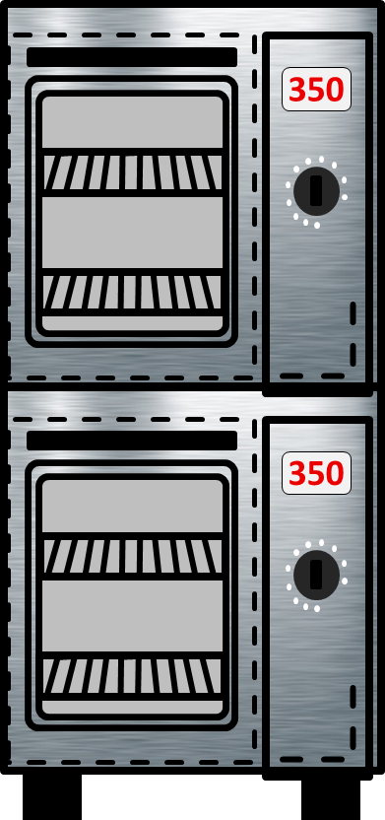
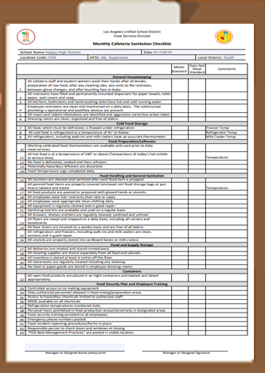
Monthly Monitor For Food Safety
A monthly cafeteria sanitation checklist can ensure food is prepared and stored in a sanitary environment.
Answer honestly
Meets standards
Does not meet standards
Add details in the comments section
Notes:
TELL:. Do a honestly self assessment of your cafeteria . Think of it as constructive criticism , which will make your cafeteria stronger . The “Monthly Cafeteria Sanitation Checklist” is a tool managers should use throughout the month to monitor the condition of the cafeteria. Establish an end of the day walk through with your “Monthly Cafeteria Sanitation Checklist” to make sure you are in compliance.

Slide 8
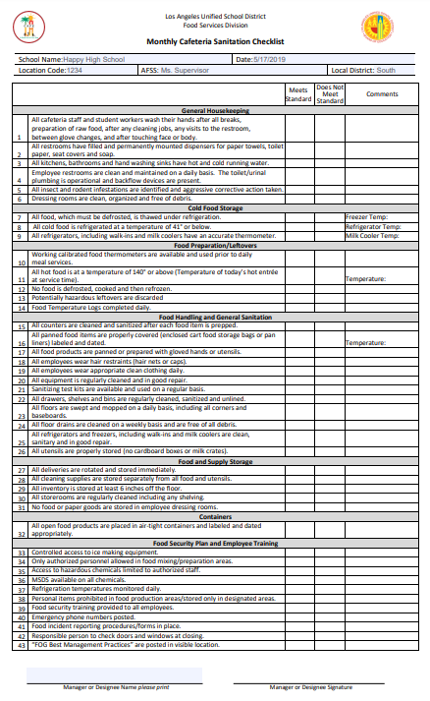
Sanitation Checklist Categories
General Housekeeping
Cold Food Storage
Food Preparations/Leftovers
Food Handling and General Sanitation
Food and Supply Storage
Containers
Food Security Plan and Employee Training
Notes:
TELL: The “Monthly Cafeteria Sanitation Checklist” is a report that will aide you in meeting standards during a Health Department inspection. When conducting your inspection for your“ Monthly Cafeteria Sanitation Checklist” answer honestly if it meets standards or does not meet standards ,there is no grey area .Completing the comment section on the “Monthly Cafeteria Sanitation Checklist” will help Identify, address and verify any possible risks that does not meet standards . Make sure you complete your “Monthly Cafeteria Sanitation Checklist” by the 15th of every month .

Slide 9
Who Can Complete The Checklist?
The responsibility of completing the “Monthly Cafeteria Sanitation Checklist” should be rotated among all food service staff.
Train staff on how to conduct the inspection
Incorporate into work schedules
Heighten staff awareness
Training Topic
Monthly
Sanitation Checklist
Notes:
TELL:. Train your staff on how to conduct the inspection by giving them a walk through of how to properly complete the “Monthly Cafeteria Sanitation Checklist”. When staff is competent , incorporate into their work schedule . The responsibility of completing the “Monthly Cafeteria Sanitation Checklist” should be rotated among all food service staff. This will heighten the staff awareness regarding the “Monthly Cafeteria Sanitation Checklist”

Slide 10
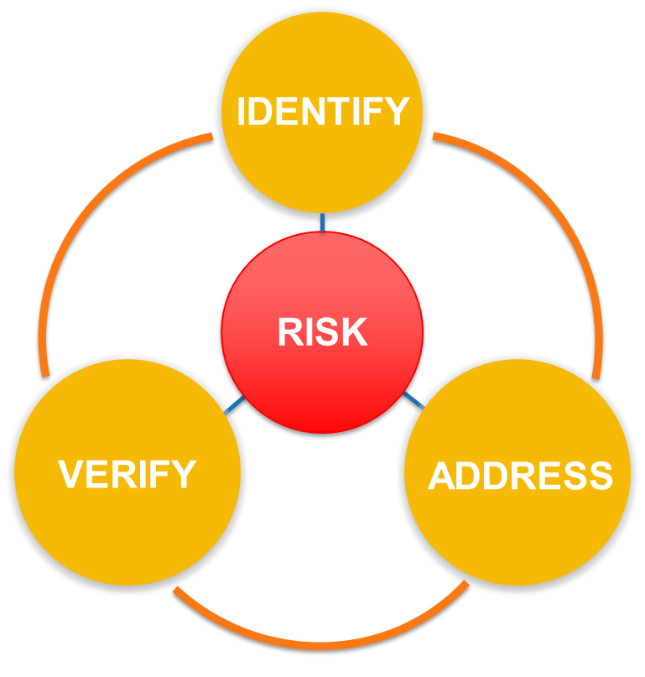
Why Practice AMC?
Using “Active Managerial Control” (AMC) regulates the food safety risks within the cafeteria.
Notes:
TELL: Evaluate every aspect of the operation and follow up with necessary corrective actions if needed. Listed are a few samples we must revaluate on a consistence basis. Evaluate Potential kitchen hazards such as slips, trips and fall hazards .
Evaluate that the HACCP logs ( “Monthly Cafeteria Sanitation Checklist”) are accurately completed.
Follow up with the effectiveness of employee training.
Evaluate the Health Department inspection report for corrective actions.

Slide 11
Active Managerial Control
“Active Managerial Control” is essential to the success of our food safety program.
Identify Risk
Address Risk
Verify Risk
Notes:
TELL: Active Managerial Control (AMC) is essential to the success of a food safety program. Food Service Managers should utilize “Active Managerial Control” (AMC) to regulate the food safety risks within the cafeteria. In the following slide we will discuss the three steps in “Active Managerial Control”

Slide 12
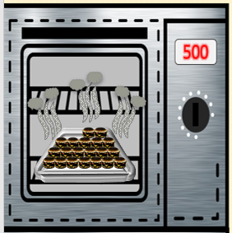
Identify Risks
Formulate a plan to address issues.
Unsanitary work attire
IDENTIFY
Improper use of personal protective equipment
RISK
Incorrect cooking techniques
Notes:
TELL: The first step in Active Manager Control (AMC) is to Identify the risks in the cafeteria and formulate a plan to address the problem. Common findings include Incorrect cooking techniques, improper dating of inventory, improper use of personal protective equipment and Unapproved work attire.

Slide 13
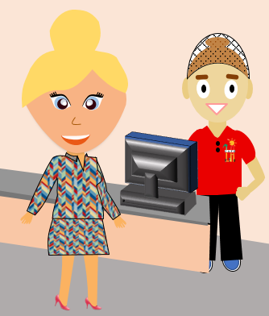
Address Risks
As you identify them, make corrective actions before other issues arise.
If customers bring issues to your attention, re-train staff
IDENTIFY
Re-train staff if HACCP logs are not completed correctly
RISK
Contact a Pest Control Operator
to address pest activity
ADDRESS
Notes:
TELL: The second step in Active Manager Control (AMC) is to address the risks as you identify them, make corrective actions before other issues arise. Example: If your staff is not completing the Food Temperature logs correctly , address the risk that you identify and re-train staff on how to correctly fill out the Food Temperature Log

Slide 14
Verify Risk Prevention
Verify corrective actions have been taken for the risks that were identified.
IDENTIFY
Confirm the HACCP logs information is correct
RISK
Follow up with Pest Management Technician
VERIFY
ADDRESS
Notes:
TELL: This is the final step in Active Manager Control (AMC), You must verify the appropriate corrective actions have been taken for the risks that were identified and addressed.
Example: Once the Food Temperature logs have been completed by your staff, Verify that the information is correct .Sign the Food Temperature logs once you have Verified the information is is true, correct and in accordance with Food Services policies and procedures.

Slide 15
Active Managerial Control
Hold your cafeteria to the highest standard by practicing managerial control and complete a daily walk through and a monthly cafeteria sanitation checklist.
Remember Active Managerial Control
Identify – Give honest assessment
Address - Corrective action
Verify - Staff monitoring and re-training
Notes:
TELL: When managers complete the “Monthly Cafeteria Sanitation Checklist” candidly they are holding their cafeteria to the highest standard. When conducting your inspection utilize the “Active Managerial Control” by Identifying the risk honestly , addressing the corrective action and monitoring staff to verify they are completing the “Monthly Cafeteria Sanitation Checklist” correctly .The verification step may indicate that retraining is necessary .

Slide 16
Conduct a Daily Operation Walk-Through
A daily walk-through includes a visual inspection of the entire cafeteria.
Look for the following:
Insects
Rodent droppings
Spider webs
Trash and debris on floor
Food left out
Dust
Equipment failure
NOTE: Do not avoid looking underneath equipment.
Notes:
Tell: During your morning walk-through, includes a visual inspection of the entire cafeteria. When conducting your morning inspection, make sure you are looking underneath equipment for trash , rodent droppings, spider webs, insects and debris .

Slide 17
Get All Staff Involved
Train your staff to identify any food safety risk and to conduct visual inspections throughout the day. This will serve as another set of eyes maintaining the integrity of your operation.
Notes:
Tell: During your morning walk-through, includes a visual inspection of the entire cafeteria. When conducting your morning inspection, make sure you are looking underneath equipment for trash , rodent droppings, spider webs, insects and debris .

Slide 18
Gretchen Reflection
Let’s Discuss:
How often should you conduct a daily walkthrough?
Where should it take place?
When is it done?
Notes:
TELL: This is the final step in Active Manager Control (AMC), You must verify the appropriate corrective actions have been taken for the risks that were identified and addressed.
Example: Once the Food Temperature logs have been completed by your staff, Verify that the information is correct .Sign the Food Temperature logs once you have Verified the information is is true, correct and in accordance with Food Services policies and procedures.

Slide 19
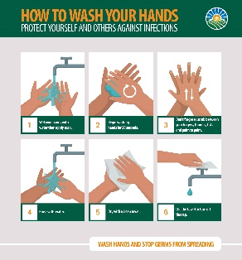
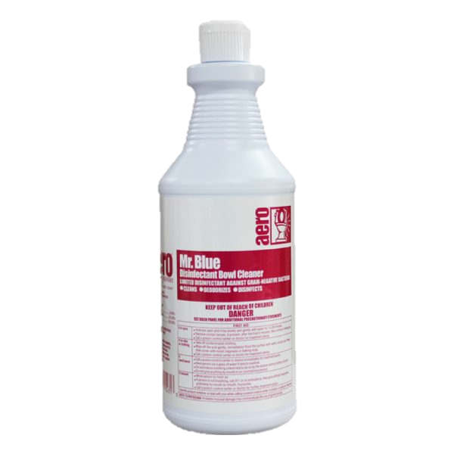
Monitor For Food Safety
Oh My!
I better report these pests to my manager.
Identify and report pest activity in the cafeteria to Pest Management Technician.
Follow up to ensure issue has been corrected.
Train employees to recognize signs of pests.
Notes:
NEXT SLIDE

Slide 20
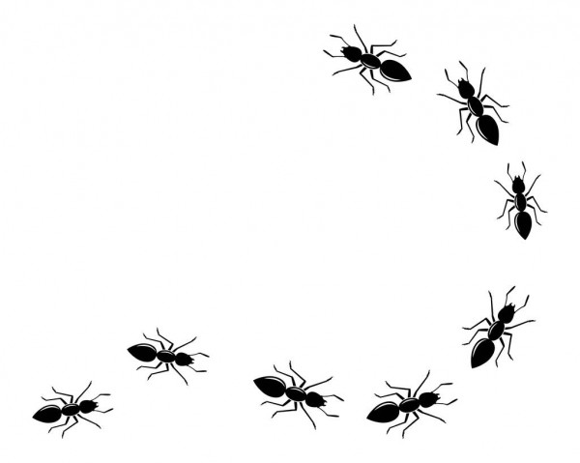
Keep Pests Out Of The Cafeteria
Pest activity from rodents, roaches, and ants is classified as urgent.
Rodents
Roaches
Ants
URGENT
Report pest activity in the cafeteria immediately!
Notes:
READ: Please read slide

Slide 21
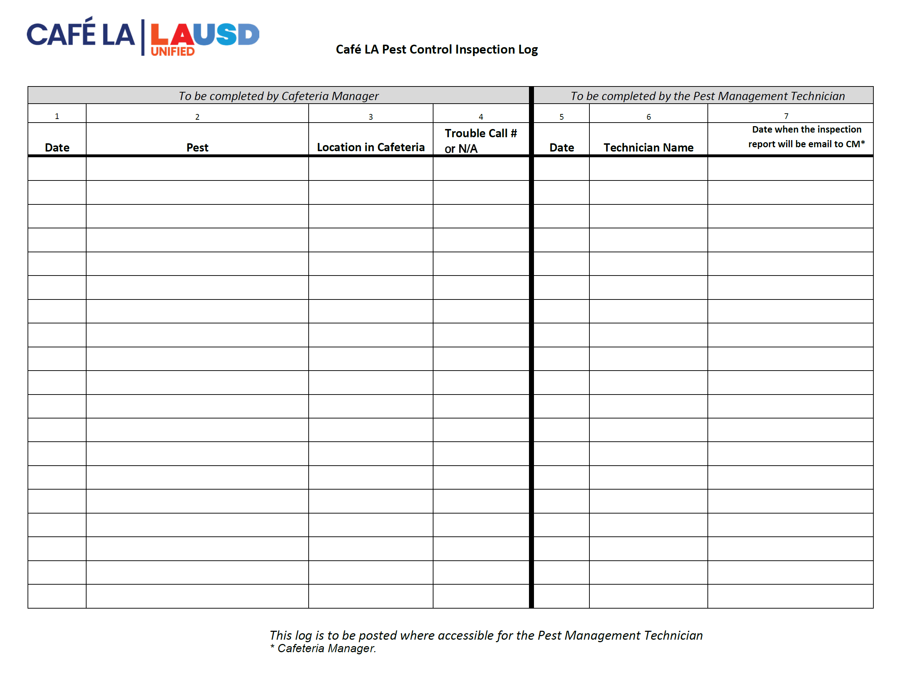
Pest Control Inspection Log
Report pest activity immediately by placing an M&O Service request. Use the Pest Control Inspection Log to document ALL service requests.
Review HACCP SOP Integrated Pest Management for additional guidance.
Notes:
READ: Please read slide

Slide 22
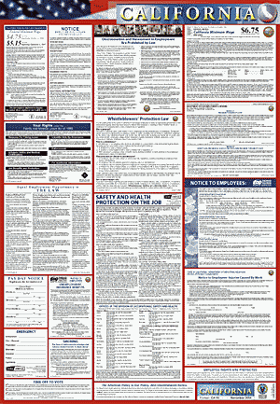
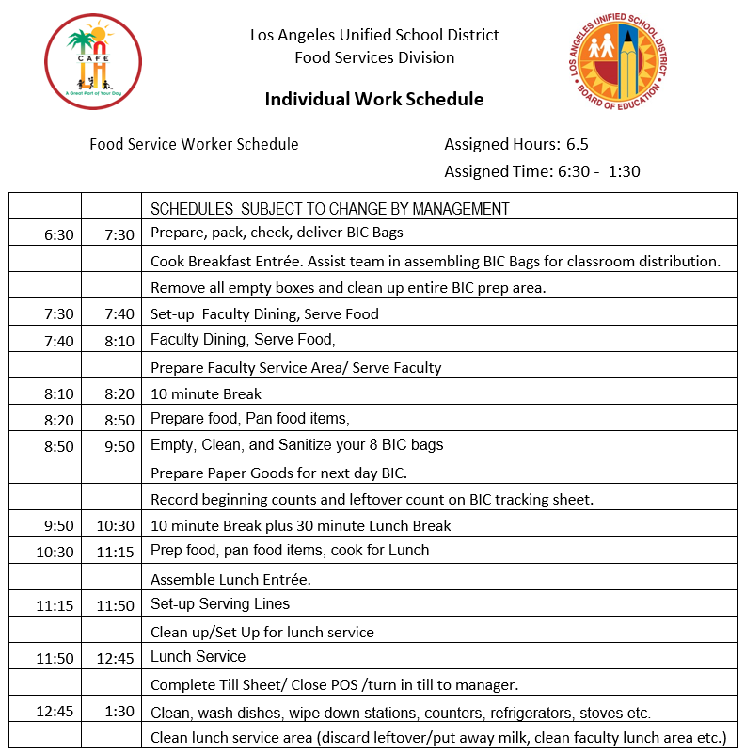
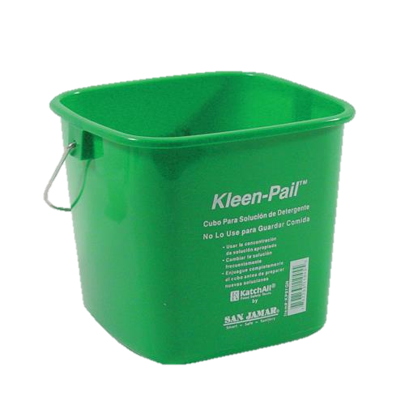
Clean and Sanitize
Cafeteria work areas are not always in the same condition they were the day before. Clean and sanitize surfaces prior to use.
Overnight visitors can include:
Pest activity
School staff
Delivery people
Sanitizer
Notes:
Tell: Cafeteria work areas are not always in the same condition they were the day before. Overnight visitors can include ,pest activity, School staff and Delivery personnel .
Clean and sanitize surfaces prior to use following the five step process .
1.Pre-clean - remove excess food waste by wiping counter.
2.Main clean - loosen surface waste and grease using a detergent.
3.Rinse - remove loose food waste, grease and detergent with clean water .
4.Disinfection - kill the bacteria with disinfectant .
5.Air Drying – allow the sure to dry on it own to remove all moisture.

Slide 23
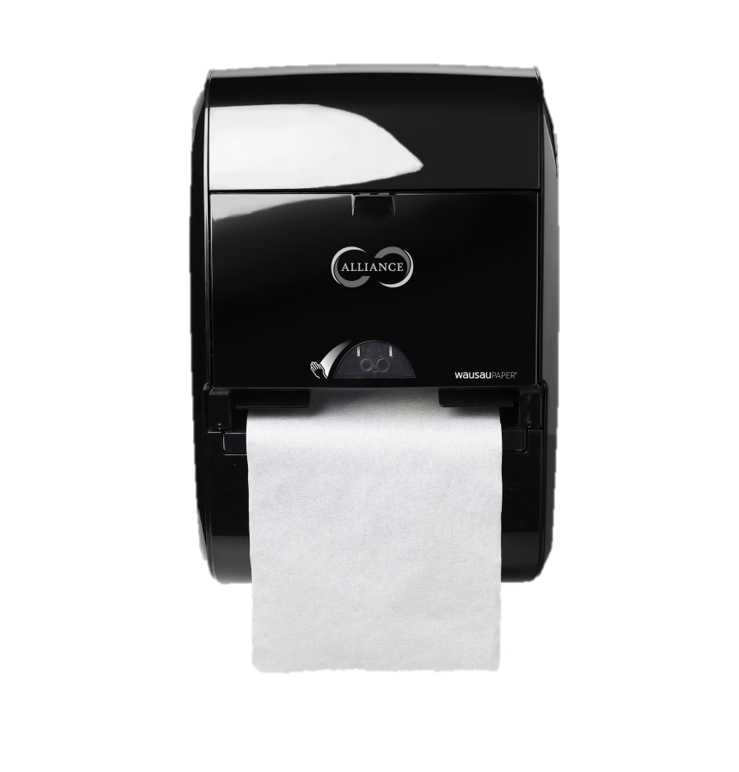
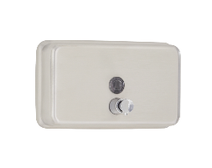
Hand Wash Sink
Work with the site custodian to ensure the hand wash sink is always stocked with the following:
Single-Use Paper Towels
Signage
Soap
Hot and Cold
Running Water
Garbage
Container
Notes:
Tell: By working with the Plant Manager to ensure the hand wash sink is always has following: filled soap dispenser soap , signage that indicates “Employees Must Wash Hands’’, and single use paper towels, garbage container and cold and hot running water at least 100 degrees F.

Slide 24
Single Use Gloves
Single use gloves are required during food preparation.
Keep vinyl gloves readily available at each workstation
Provide a variety of glove sizes
Never use gloves in place of handwashing
Change gloves any time you would need to wash your hands after:
Touching your body
Visiting the restroom
Eating or drinking
Handling dirty utensils or equipment
Preparing potentially hazardous food items
Any other activities that contaminate gloves
Notes:
Tell: Keeping vinyl gloves readily available at each work station in a verity of sizes , will ensure your staff have the proper tools to safely serve meals in compliance with the “Food Safety Plan you are aiding your staff in the right direction .Never use gloves in place of hand washing . You must remind your staff that they must change gloves after touching other surfaces such as doors or telephones to ensure we are not cross contamination .

Slide 25
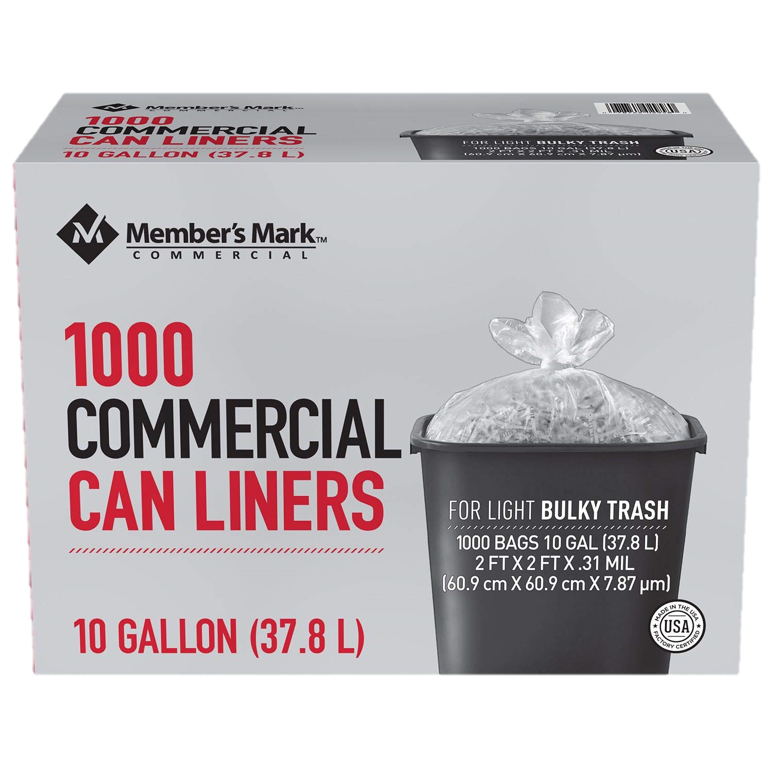
Employee Dressing Room
Cafeteria restrooms and employee's locker area are not to be used for storage. This includes:
Food supplies
Paper goods
Chemicals
Cleaning supplies
NOTE: A small supply of hairnets and aprons is permitted.
Notes:
Tell: Cafeteria restrooms and employees locker area are not to be use for storage of food supplies ,paper goods, chemicals or Cleaning supplies. A small supply of hairnets and aprons is permitted .

Slide 26
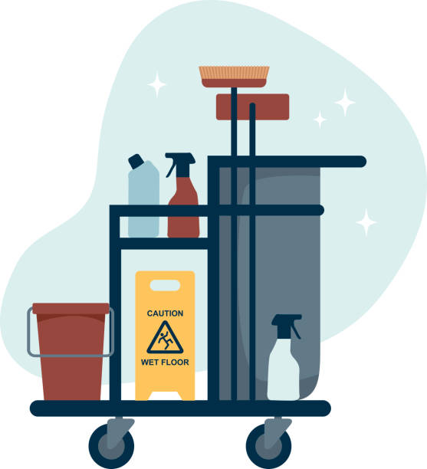
Hopper Room
If the hopper room is adjacent to the cafeteria the health department will include it in their report.
Things to do:
Visual inspection
Check for pest activity
Ensure the room is clean
Maintain with Plant Manager
Hopper room violations affect the cafeteria health inspection report.
Notes:
Tell: If the hopper room is adjacent to the cafeteria, the health department will include it in their "Retail Food Official Inspection Report". To make sure we are in compliance, do a visual inspection. Check for pest activity, ensuring the room is clean .

Slide 27
Getting Control Of Your Cafeteria
During your daily walk-through, give your cafeteria a thorough assessment. Ask yourself the following questions:
What is the condition of the operation?
Am I being honest with my answers?
Are the answers “yes” or “no”?
Is there any grey area?
When answering questions candidly, this allows for improvement!
Notes:
TELL: Active Managerial Control (AMC) is essential to the success of a food safety program. Food Service Managers should utilize “Active Managerial Control” (AMC) to regulate the food safety risks within the cafeteria. In the following slide we will discuss the three steps in “Active Managerial Control”

Slide 28
Get Your Operation FIT
Are you ready to get
F
I
T
?
Notes:
Tell:

Slide 29
Notes:
Tell : The “R” in ALERT stands for Reports . Provide reports about the safety of the products we serve. Stay up to date with Daily Update messages, food recall notices, and district notifications regarding potential threats.

Slide 30
T
TOP
IN BETWEEN
I
F
FLOOR
Notes:
Tell : The “R” in ALERT stands for Reports . Provide reports about the safety of the products we serve. Stay up to date with Daily Update messages, food recall notices, and district notifications regarding potential threats.

Slide 31
FIT requires you to observe all areas of the operation, top to bottom.
T
I
F

Slide 32
The floor is the most overlooked area of the kitchen. Lower areas tend to be darker, use a flashlight for better vision.
Inspect floor drains, corners and coving
Look under counters, prep tables, ovens, stoves and shelving
Check for signs of pests
Address pooling water and leaking pipes
Clean food spills
Remove fallen debris and dust particles
Floor
Notes:
Tell : The “R” in ALERT stands for Reports . Provide reports about the safety of the products we serve. Stay up to date with Daily Update messages, food recall notices, and district notifications regarding potential threats.

Slide 33
This is everything at eye-level. Look in between, inside and on shelves, drawers and walls for:
Correct FIFO process, ensuring inventory is not expired
Signs of pests
Debris and dust on shelves, counters and walls
Chipping paint, rust and mold
Ice buildup
Clean hand washing stations
Inverted small wares
In Between
Notes:
Tell : The “R” in ALERT stands for Reports . Provide reports about the safety of the products we serve. Stay up to date with Daily Update messages, food recall notices, and district notifications regarding potential threats.

Slide 34
Bend your head back to look up or use a stepladder when necessary. Inspect the tops of kitchen equipment and all areas over your head.
Signs of leakage
Cobwebs
Missing or broken ceiling tiles
Light shields and missing or burnt-out lightbulbs
Pest activity
Dust and debris
Air and oven filters
Grease traps
Top
Notes:
Tell : The “R” in ALERT stands for Reports . Provide reports about the safety of the products we serve. Stay up to date with Daily Update messages, food recall notices, and district notifications regarding potential threats.

Slide 35
T
T
T
I
I
I
F
F
F

Slide 36
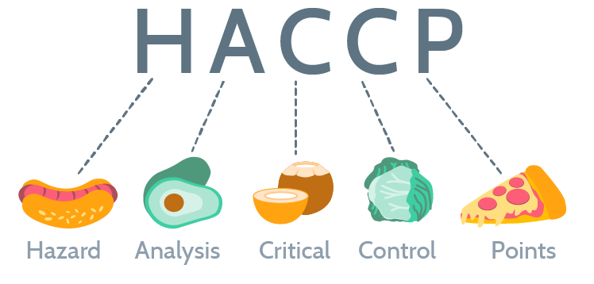
HACCP
HACCP is a systematic preventive approach to food safety identifying hazards in the production process.
Notes:
TELL: Evaluate every aspect of the operation and follow up with necessary corrective actions if needed. Listed are a few samples we must revaluate on a consistence basis. Evaluate Potential kitchen hazards such as slips, trips and fall hazards .
Evaluate that the HACCP logs ( “Monthly Cafeteria Sanitation Checklist”) are accurately completed.
Follow up with the effectiveness of employee training.
Evaluate the Health Department inspection report for corrective actions.

Slide 37
Hazard Analysis Critical Control Points
Conduct A Hazard Analysis
Identify Critical Control Points
Establish Critical Limits
Monitor Critical Control Points
7 Principles of HACCP
Establish Corrective Action
Verification
Record Keeping
Notes:
TELL: We are going to introduce a concept that ensures you apply the Seven Principles of HACCP, called AMC

Slide 38
Temperature Hazards
Without managerial control, temperature hazards can occur.
Did you know bacteria doubles every 20 minutes?
DANGER
Hey Gretch…don’t forget to RSVP to the party! See you there!
Notes:
TELL: Evaluate every aspect of the operation and follow up with necessary corrective actions if needed. Listed are a few samples we must revaluate on a consistence basis. Evaluate Potential kitchen hazards such as slips, trips and fall hazards .
Evaluate that the HACCP logs ( “Monthly Cafeteria Sanitation Checklist”) are accurately completed.
Follow up with the effectiveness of employee training.
Evaluate the Health Department inspection report for corrective actions.

Slide 39
DANGER

Slide 40
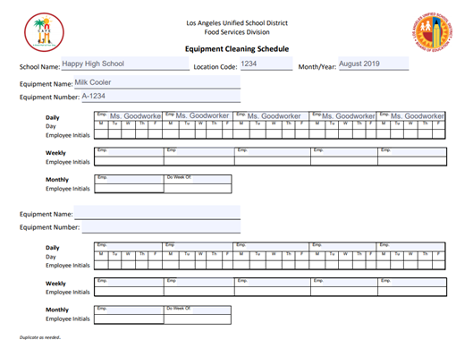
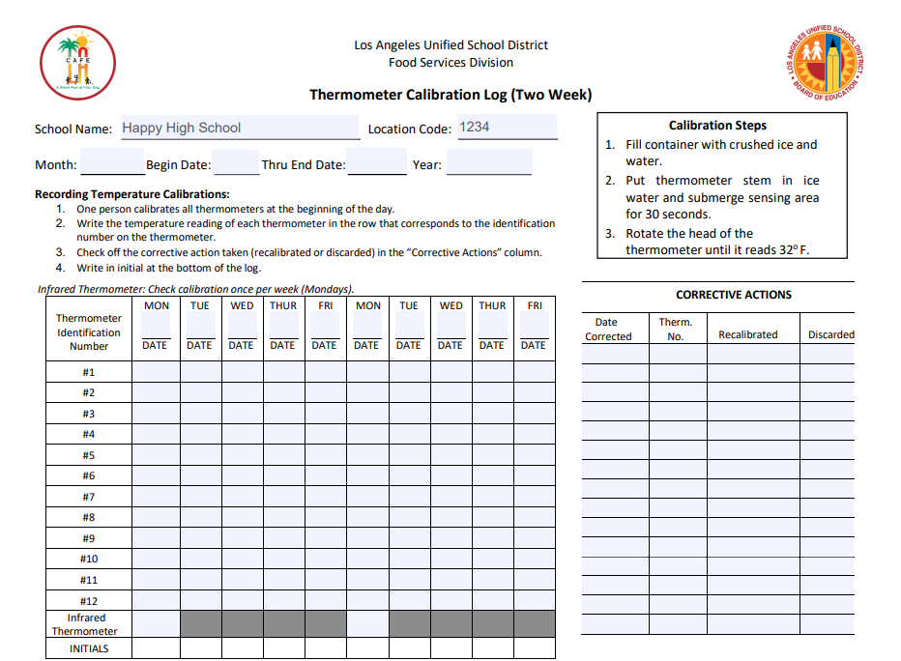
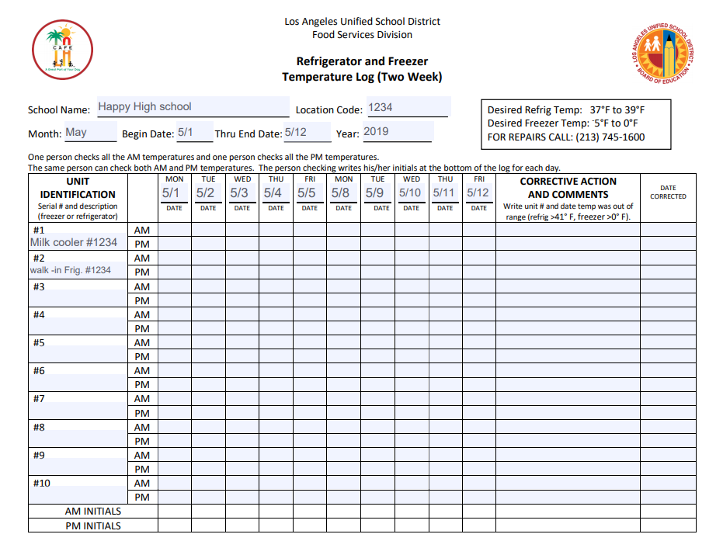
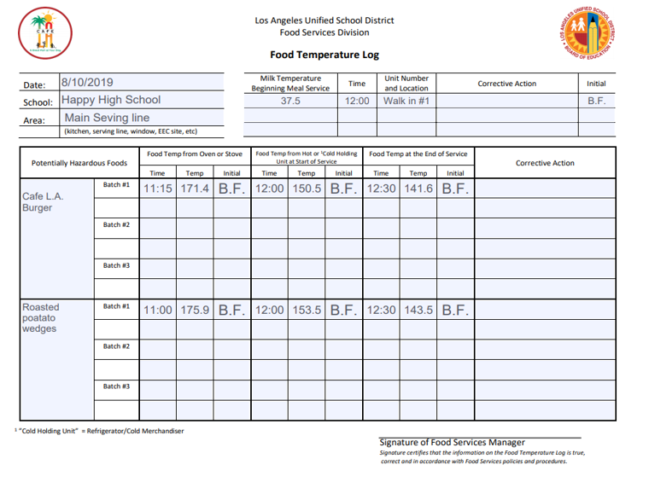
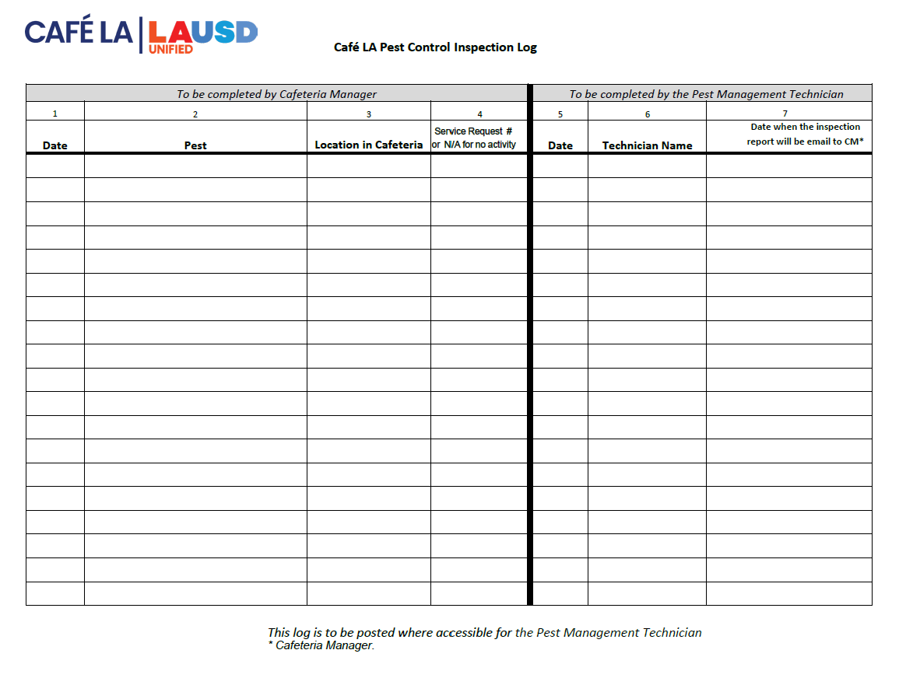
Food Temperature Log
HACCP logs are the written verification that support the food safety plan.
Refrigerator and Freezer Log
Pest Control Log
Equipment Cleaning Log
Thermometer Calibration Log
Monthly Sanitation Checklist
Notes:
TELL: Here are some examples of the HACCP logs we use on a daily basis . Food Temperature Log” , “Monthly Sanitation Checklist “, “Pest Control Log”, “Equipment Cleaning Log” , “Thermometer Calibration Log”, and the “Refrigerator and Freezer Log”. Each form must have its own manila folder and filed according to the “Record Retention Guidelines” and placed in Folder # 2 in your file cabinet .

Slide 41
Before I can take any food temperature, I must calibrate the thermometers.
Notes:
NEXT SLIDE

Slide 42
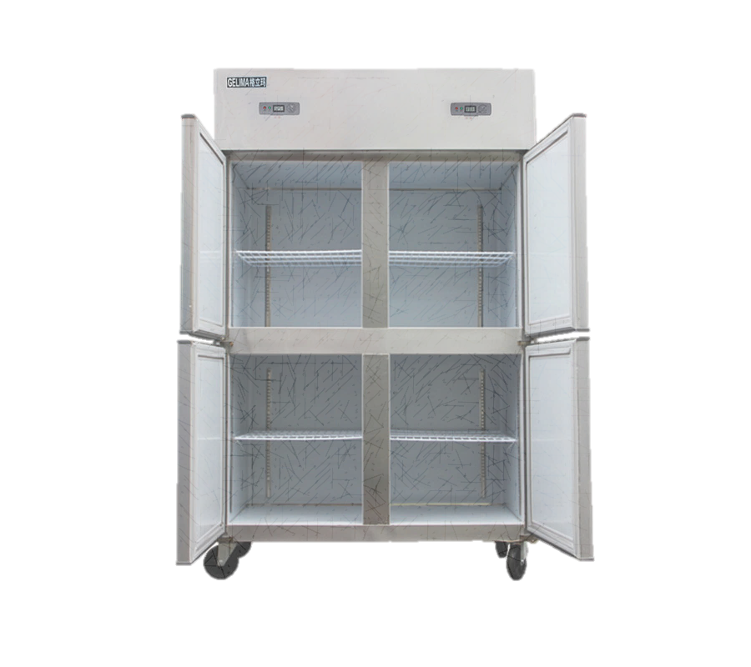
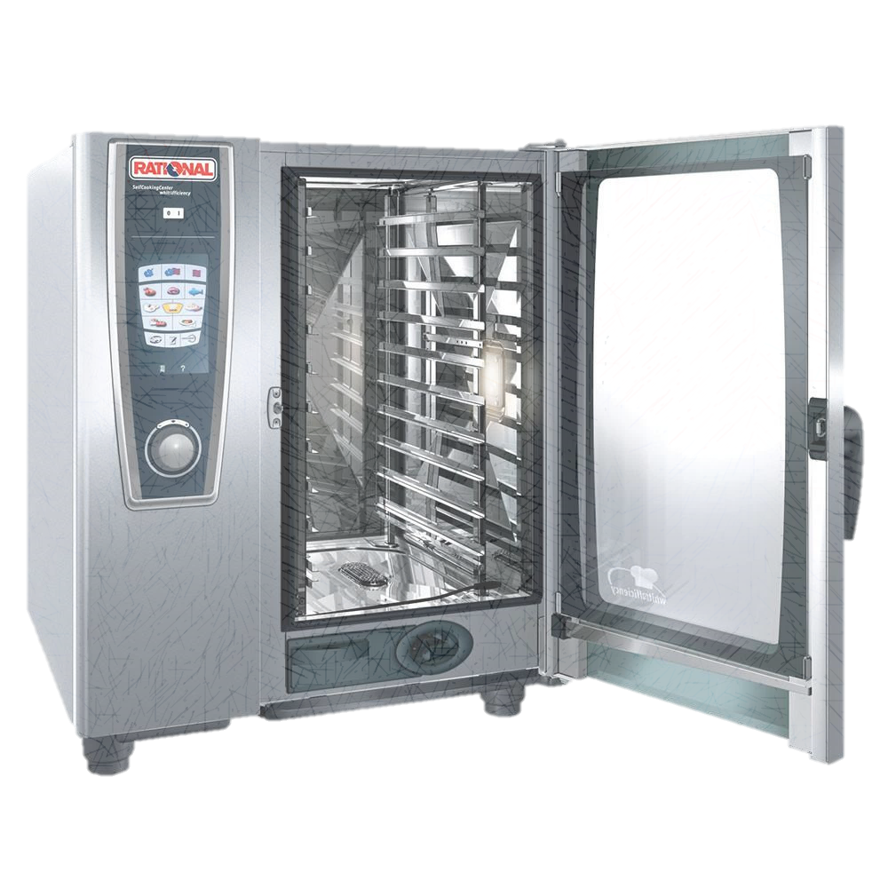
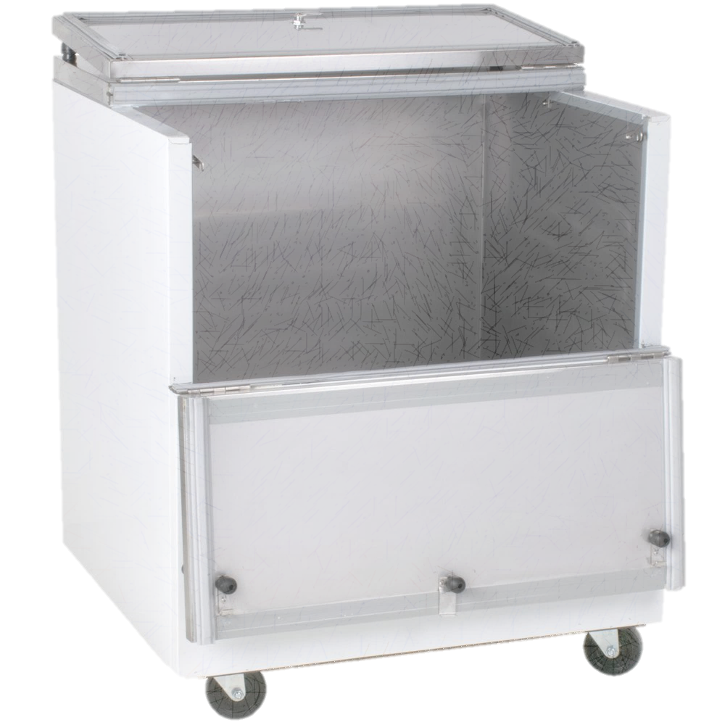
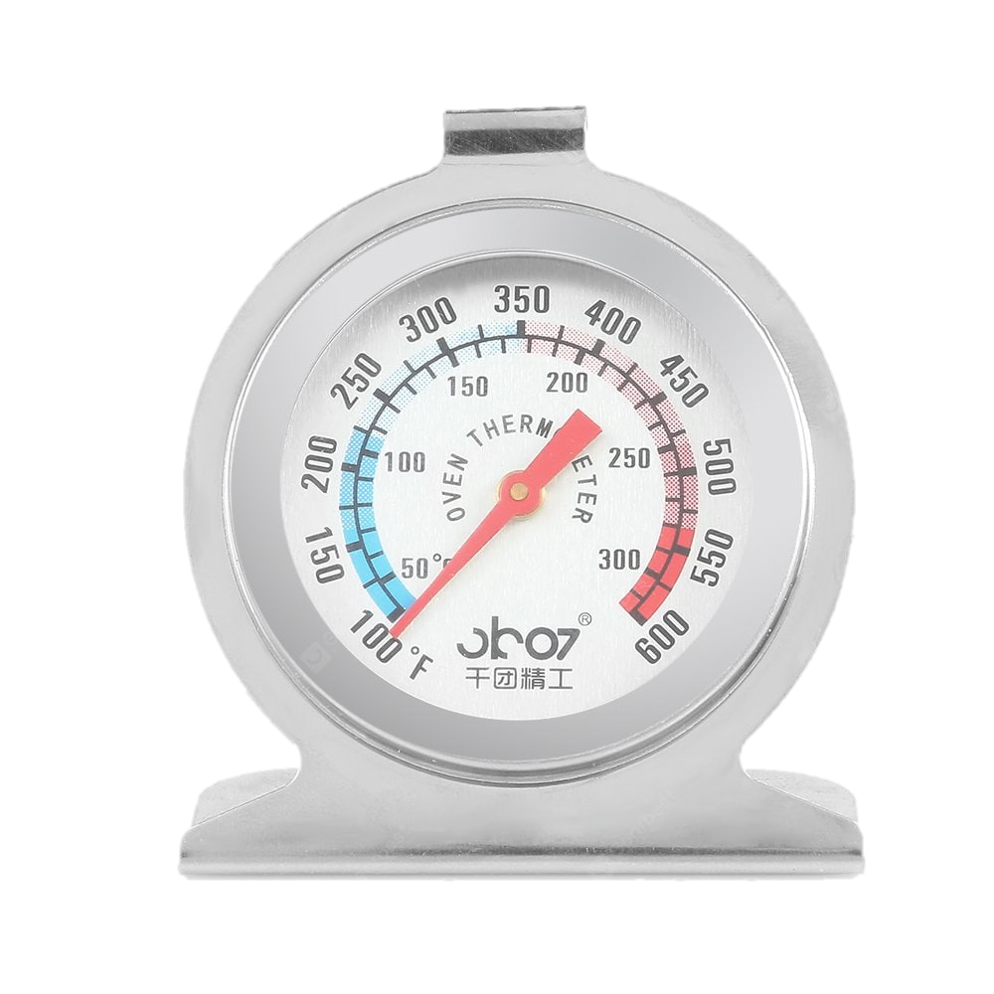
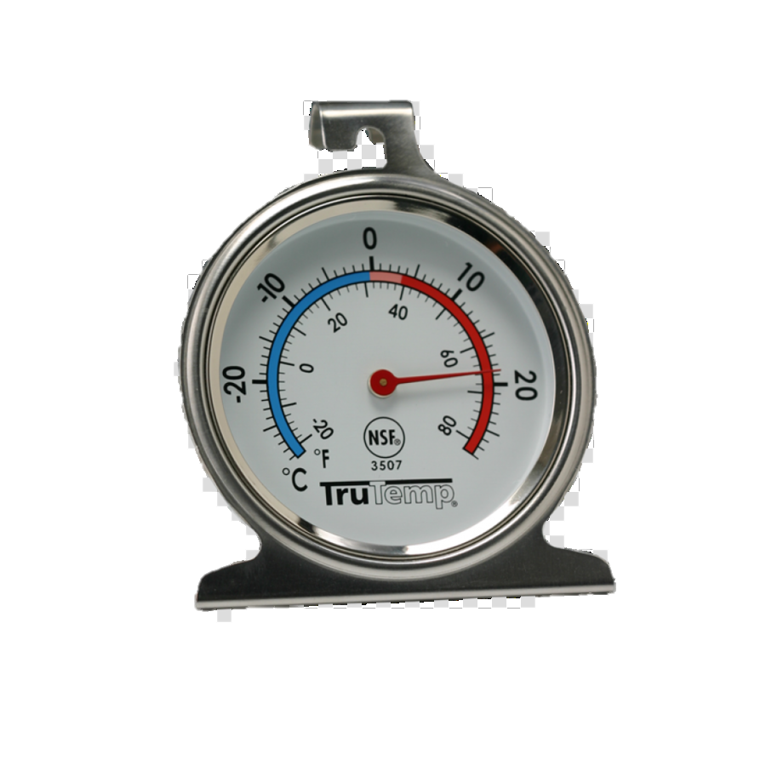
Secondary Thermometers
All refrigerators, milk coolers, freezers, and ovens must have two functional thermometers.
Add a secondary thermometer if needed
Ensure the appropriate thermometer is used
Notes:
TELL: All refrigerators, milk coolers, freezers, and ovens should have two functional thermometers. In addition to the thermometer installed in the equipment, a secondary thermometer must be present to be incompliance with the “Food Safety Plan”. Please order from the Food Service Warehouse . Be mindful that we have two kind in stock, one for hot equipment and one for cold equipment .

Slide 43
Refrigerator and Freezer Temps
It is vital that refrigerator and freezer temperatures are checked at the beginning and end of each day.
Record temperatures on “Refrigerator and Freezer Temperature Log”
Corrective action when equipment is not operating properly
Avoid having foods fall into the temperature danger zone
Relocate product to a working unit if not operating properly
Notes:
Tell: It is vital that refrigerator and freezer temperatures are checked at the beginning and end of each day to ensure that they are in good working condition. Record temperatures on “Refrigerator and Freezer Temperature Log”’ , once in the morning and once in the afternoon. If the refrigerator or freezer is not in the appropriate temperature zone , relocate food to a working unit. Avoid having foods fall into the temperature danger zone by keeping doors shut when not in use . Make corrective actions when equipment is not operating properly , place a trouble call or input a ticket to Maintenance and Operations(M&O) for repairs managers.

Slide 44
Power Outages
Have you ever wondered if your power may have gone out when you weren’t at work?
Well, have I got a helpful tip for you!
Notes:
TELL : Food safety is important as it helps to protect students from the risk of foodborne illnesses.

Slide 45
Freezer Coin Test
Step 1: Fill a container with water about 2-3 inches deep and freeze.
Step 2: Verify the water is in a solid frozen state.
Place a coin on top of ice.
Notes:
Tell: Cafeteria work areas are not always in the same condition they were the day before. Overnight visitors can include ,pest activity, School staff and Delivery personnel .
Clean and sanitize surfaces prior to use following the five step process .
1.Pre-clean - remove excess food waste by wiping counter.
2.Main clean - loosen surface waste and grease using a detergent.
3.Rinse - remove loose food waste, grease and detergent with clean water .
4.Disinfection - kill the bacteria with disinfectant .
5.Air Drying – allow the sure to dry on it own to remove all moisture.

Slide 46
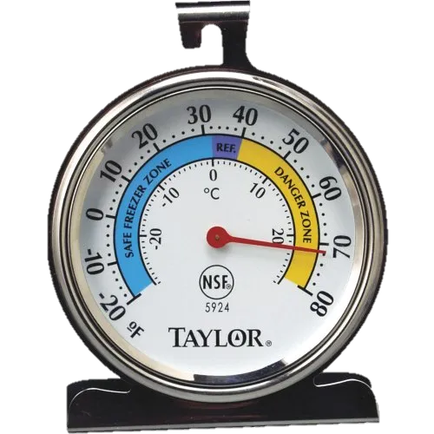
Freezer Coin Test
Step 3: Place container on a shelf closest to thermometer near the warmest part of the freezer (top and near door)
Notes:
Tell: Cafeteria work areas are not always in the same condition they were the day before. Overnight visitors can include ,pest activity, School staff and Delivery personnel .
Clean and sanitize surfaces prior to use following the five step process .
1.Pre-clean - remove excess food waste by wiping counter.
2.Main clean - loosen surface waste and grease using a detergent.
3.Rinse - remove loose food waste, grease and detergent with clean water .
4.Disinfection - kill the bacteria with disinfectant .
5.Air Drying – allow the sure to dry on it own to remove all moisture.

Slide 47
Freezer Coin Test
Step 4: If the coin is still resting on ice, freezer did not lose power and food quality was not compromised.
Notes:
Tell: Cafeteria work areas are not always in the same condition they were the day before. Overnight visitors can include ,pest activity, School staff and Delivery personnel .
Clean and sanitize surfaces prior to use following the five step process .
1.Pre-clean - remove excess food waste by wiping counter.
2.Main clean - loosen surface waste and grease using a detergent.
3.Rinse - remove loose food waste, grease and detergent with clean water .
4.Disinfection - kill the bacteria with disinfectant .
5.Air Drying – allow the sure to dry on it own to remove all moisture.

Slide 48
Freezer Coin Test
If the coin is now sitting at the bottom of container, or submerged below water, the freezer’s internal temperature may have become warm enough to compromise food.
Assess and take necessary action.
Notes:
Tell: Cafeteria work areas are not always in the same condition they were the day before. Overnight visitors can include ,pest activity, School staff and Delivery personnel .
Clean and sanitize surfaces prior to use following the five step process .
1.Pre-clean - remove excess food waste by wiping counter.
2.Main clean - loosen surface waste and grease using a detergent.
3.Rinse - remove loose food waste, grease and detergent with clean water .
4.Disinfection - kill the bacteria with disinfectant .
5.Air Drying – allow the sure to dry on it own to remove all moisture.

Slide 49
Freezer Coin Test
This test does not only have to be conducted during breaks and long weekends. Make it a habit for your staff to check the coin daily for any overnight malfunctioning.
Notes:
Tell: It is vital that refrigerator and freezer temperatures are checked at the beginning and end of each day to ensure that they are in good working condition. Record temperatures on “Refrigerator and Freezer Temperature Log”’ , once in the morning and once in the afternoon. If the refrigerator or freezer is not in the appropriate temperature zone , relocate food to a working unit. Avoid having foods fall into the temperature danger zone by keeping doors shut when not in use . Make corrective actions when equipment is not operating properly , place a trouble call or input a ticket to Maintenance and Operations(M&O) for repairs managers.

Slide 50
Food Safety Plan
The Food and Drug Administration (FDA) requires a written food safety plan. Food Services organizations need to establish a food safety plan that includes:
Education and Training
Hazard Analysis
Food Safety Plan
Preventive Controls
Reanalysis
Notes:
TELL: The Food and Drug Administration (FDA) requires a written food safety plan. Food Services Division (FSD) has an established HACCP( Hazard Analysis and Critical Control Point) food safety plan that includes Education and Training, Hazard Analysis, Preventive Controls and Reanalysis. In the following slides we will go over the required steps in The Food Safety Plan .

Slide 51
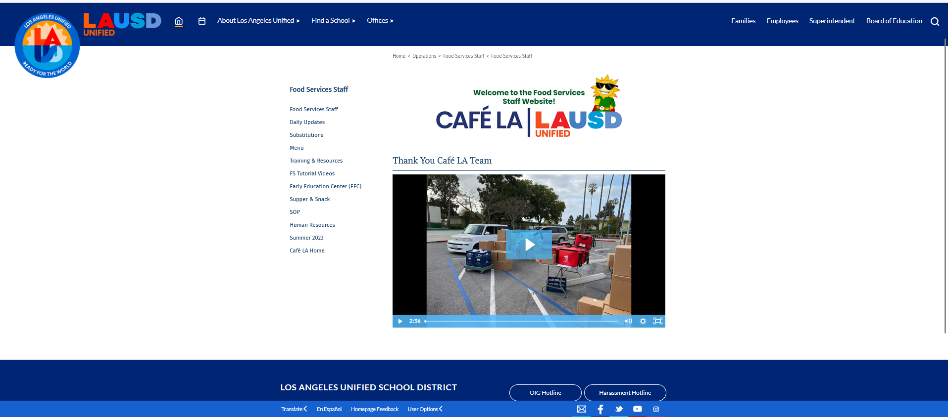
Education and Training
By providing your staff with training you are accomplishing a portion of the education and training element of the “Food Safety Plan”.
Training includes:
Managers Orientation
New Employee Training (NET)
Managers Certification Course (MCC)
Food Safety and Sanitation Monthly Training
Manager Refresher Training (MRT)
Conferences
Notes:
TELL:Always offer a copy of agendas
By providing your staff with the “Monthly Cafeteria Sanitation Training,” you are accomplishing a portion of the education and training element of the food safety plan. Some additional training provided by Food Services is Managers Orientation , Managers Certification Course and My PLN training .

Slide 52
Hazard Analysis
A hazard analysis is used to assess risk. A “Monthly Cafeteria Sanitation Checklist.” is a tool used by food service professionals to aide in the prevention of foodborne illness.
Notes:
TELL: A hazard analysis is used to assess risk. A hazard is any agent that can cause harm or damage to humans, property, or the environment. Some examples are metal fragments from worn or chipped utensils and containers . One tool used by Food Services to aide in the prevention of foodborne illness is the “Monthly Cafeteria Sanitation Checklist.”

Slide 53
Preventive Controls
Preventive controls are designed to avoid errors from occurring during the flow of food.
Notes:
TELL: Preventive controls are designed to avoid errors from occurring. HACCP logs are a proactive measure managers use on a daily basis to protect our customers. The rule on Preventive Controls for Human Food is mandated by the 2011 FDA Food Safety Modernization Act.

Slide 54
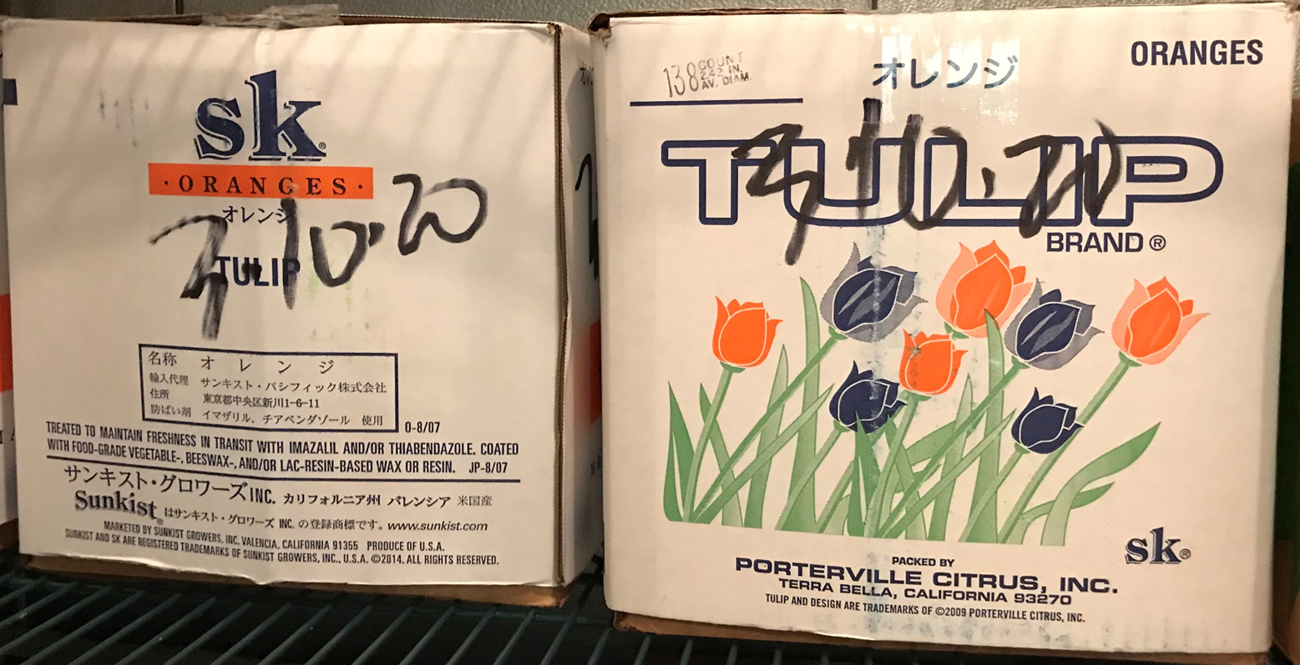
Reanalysis
Evaluate every aspect of the operation and follow up with necessary corrective actions.
Good job at training Nikki on the HACCP logs.
Thank you, I trained her just like you trained me!
Routine self inspection
Potential kitchen hazards
HACCP logs accurately completed
Effectiveness of employee training
Health department inspection report
Notes:
TELL: Evaluate every aspect of the operation and follow up with necessary corrective actions if needed. Listed are a few samples we must revaluate on a consistence basis. Evaluate Potential kitchen hazards such as slips, trips and fall hazards .
Evaluate that the HACCP logs ( “Monthly Cafeteria Sanitation Checklist”) are accurately completed.
Follow up with the effectiveness of employee training.
Evaluate the Health Department inspection report for corrective actions.

Slide 55
The 7 Checks For Food Safety
A visual walkthrough of your site will be administered to get an idea of the conditions of the operation.
Why is this important?
Allows for corrective action
Helps keep preparation at hand for a health inspection
Communicates to central office of any refresher training or supporting guides needed for staff
Notes:
TELL : Food safety is important as it helps to protect students from the risk of foodborne illnesses.

Slide 56
The 7 Checks For Food Safety
Area Food Service Supervisors and Regional Managers will conduct this inspection for these 7 following areas:
Hand Washing and Personal Hygiene
HACCP Logs
Overstock Inventory
Food Storage
Preventative Controls
Temperature Abuse
Sanitation of Contact Surfaces
Notes:
TELL : Food safety is important as it helps to protect students from the risk of foodborne illnesses.

